Slide 1

Music Theory Lesson #2 of 5
By Free Knowledge Mission

Slide 2
What We’ll Cover
Check out Andrew Furmanczyk Music Theory lessons 01 – 50
Lesson 1 covered 01-05
I’ll plan to cover 05…….20
5 lessons in Rythym

Slide 3
#6 Dotted Notes & Triplets

Slide 4
#7 Time Signatures, Strong & Weak Beats

Slide 5
#8 Simi tones & Whole Tones

Slide 6
#9 Chromatic/Diatonic, Enharmonic Tones

Slide 7
#10 Major Scale

Slide 8
#11 Minor Scale (Natural & Harmonic) Melodic + Relative Minor

Slide 9
#12 Order of Sharps and Flats + Key Signatures

Slide 10
#13 Circle of Fifths

Slide 11
#14 Key of Music

Slide 12
#15 Upbeat or Pickup Beat

Slide 13
#16 Basic Intervals

Slide 14
#17 Intermediate Intervals

Slide 15
#18 Advanced Intervals

Slide 16
#19 Major and Minor Triads

Slide 17
#20 Scale Degrees

Slide 18
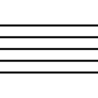
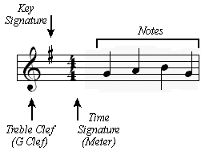
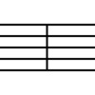
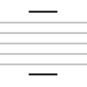
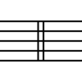
The.

Slide 19
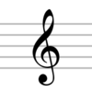
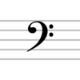
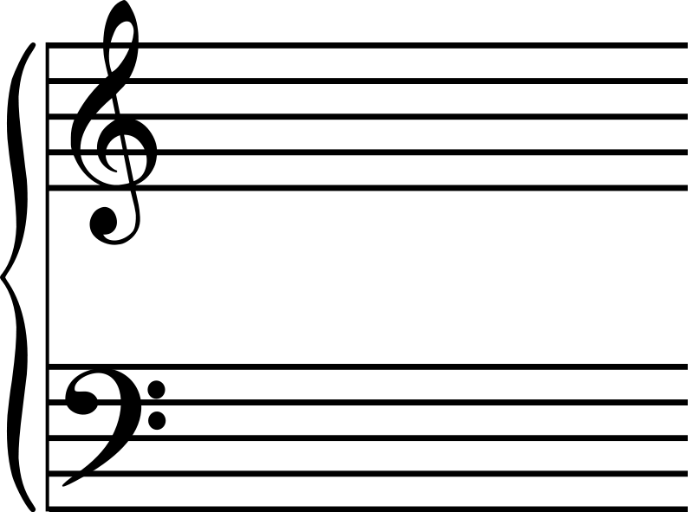


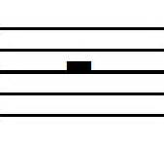


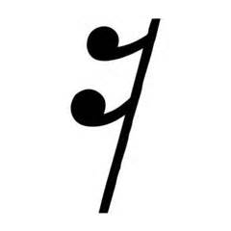





N

Slide 20
Practice
D

Slide 21
Resources
Lypur – Andrew Furmanczyk
Notes and Slides

